Slide 1
Weather Prediction
INSY 695: Enterprise Data Science
Team: Cloud Computations
Week 3 Update

Slide 2
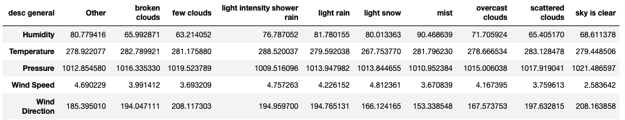
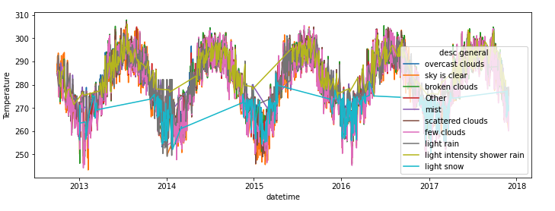
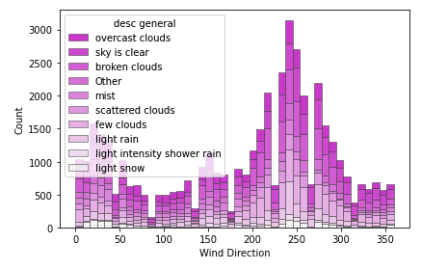
EDA Summary
Description variable

Slide 3
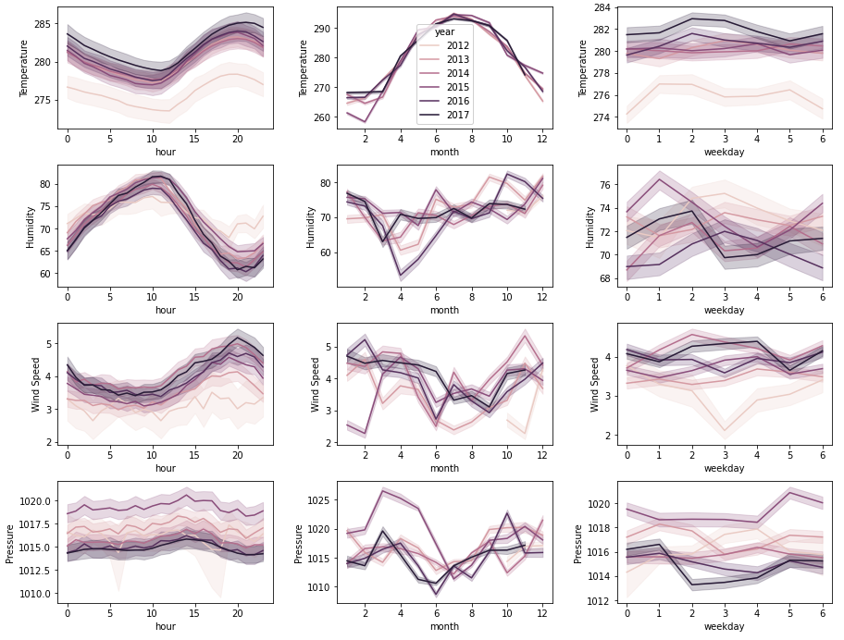
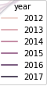
EDA Summary
Time Unit Breakdown

Slide 4
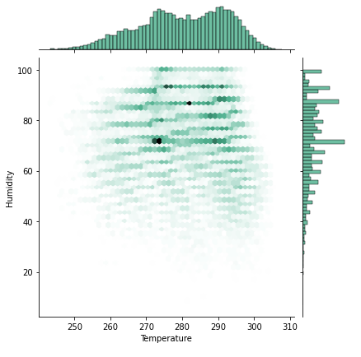
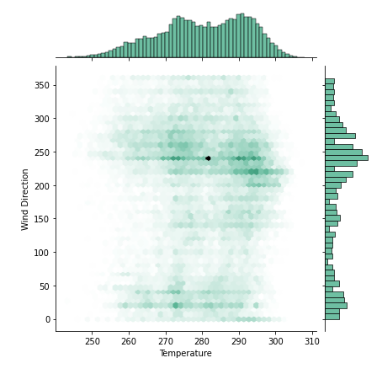
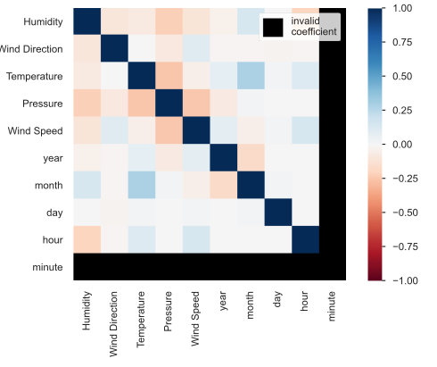
EDA Summary
Variable Interactions

Slide 5
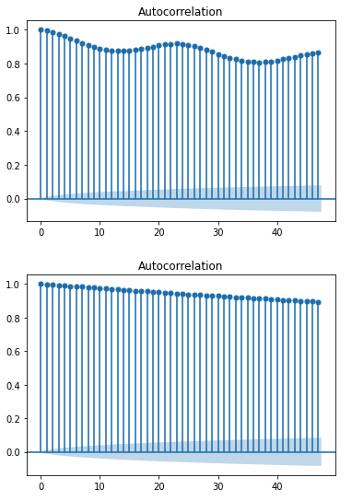
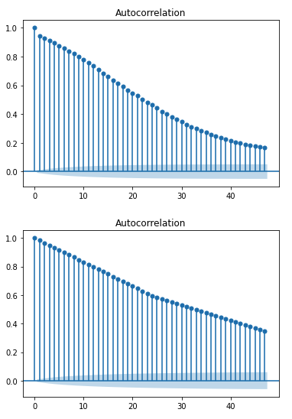
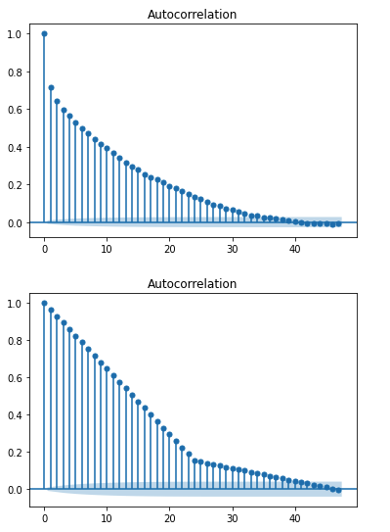
EDA Summary
Autocorrelation Plots
Temperature
Pressure
Wind Direction
Original Data
Max Daily

Slide 6
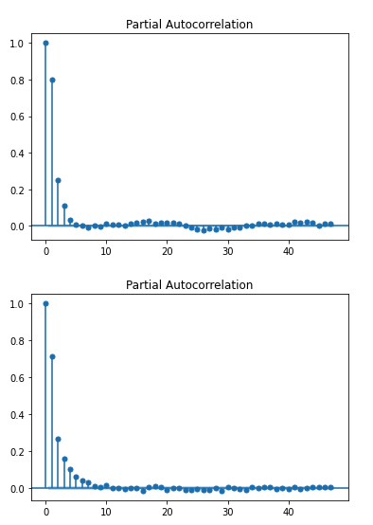
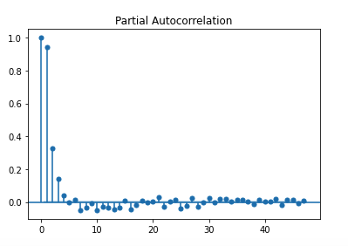
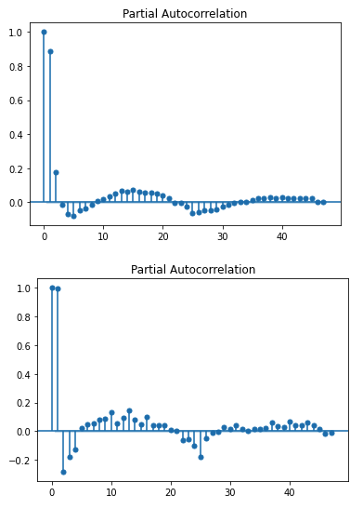
EDA Summary
Partial Autocorrelation Plots
Humidity
Wind Speed
Pressure
Temp
Wind Dir.
The partial autocorrelation at lag k is the correlation that results after removing the effect of any correlations due to the terms at shorter lags.

Slide 7
RNN
We built out RNN skeletons to predict temperatures one hour in the future
The target can be adjusted easily with our architecture
Built out two baseline models:
Model which only considers temperatures in the previous n hours
Model which considers all weather factors available from previous n hours
Interestingly, the simpler model outperformed the model with more information in our initial testing

Slide 8
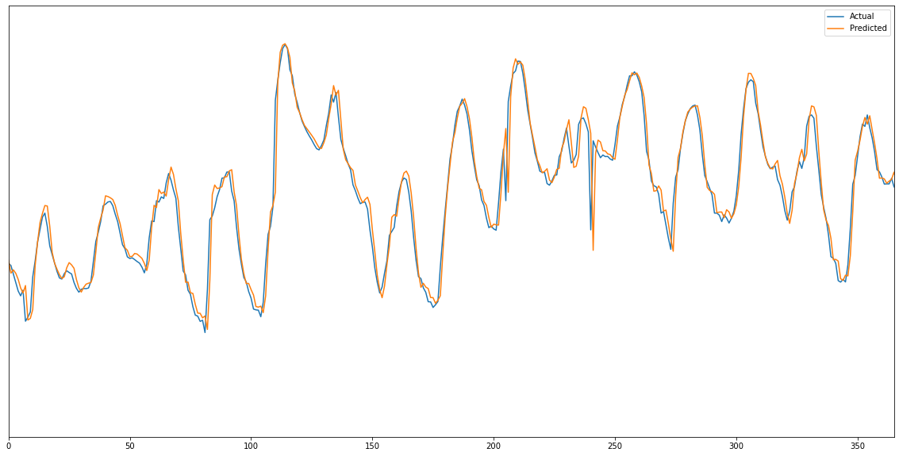
RNN - Baseline Model Sample

Slide 9
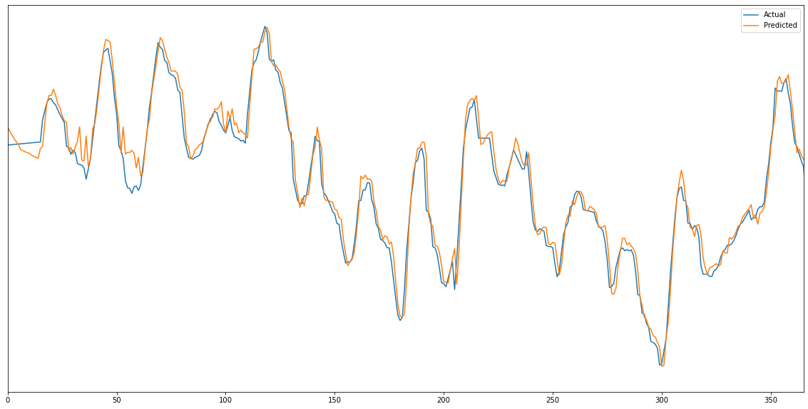
RNN - Full Information Model Sample

Slide 10
RNN - Next Steps
Hyperparameter optimization
Exploring different predictions
Different distances into future
Aggregate predictions
Implementation of transformers

Slide 11
Model Summary
Model | Predictors | RMSE
ARIMA | Past temperature | 0.64
GAM | Past temperature | 4.6
XGBoost | Past temperature | 0.61
XGBoost | Past temperature, humidity, wind direction, pressure, wind speed, etc. | 0.62
RNN | Past temperature | 0.92
RNN | Past temperature, humidity, wind direction, pressure, wind speed, etc. | 1.31

Slide 12
End

